Slide 1
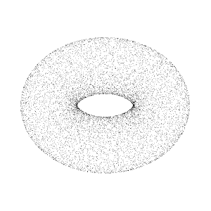
BEYOND FLATLAND: NAVIGATING THE WORLD OF 3D POINTCLOUDS
FAIZAN-E-MUHAMMAD
SOFTWARE ENGINEER at ARBISOFT

Slide 2
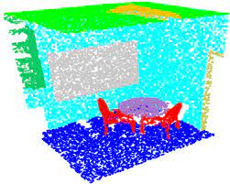
3D Point Cloud
Data points in 3D space.
N x 3 or N x (3+D) matrices.
D includes color and other attributes.
Each point denotes a specific location.

Slide 3
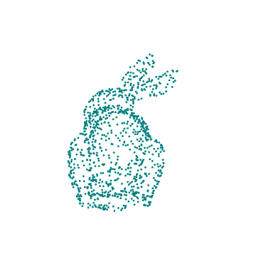
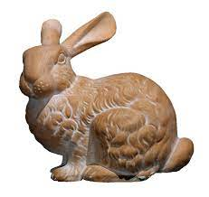
Stanford Bunny
https://community.wolfram.com/groups/-/m/t/2999089

Slide 4
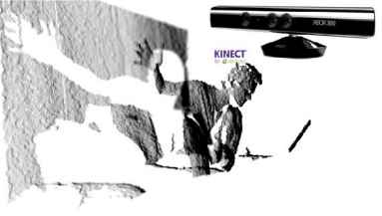

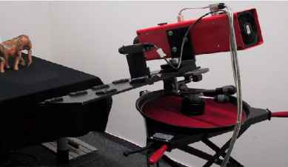
Data Acquisition
LiDAR System
Photogrammetry
CAD Models
Structure From Motion

Slide 5


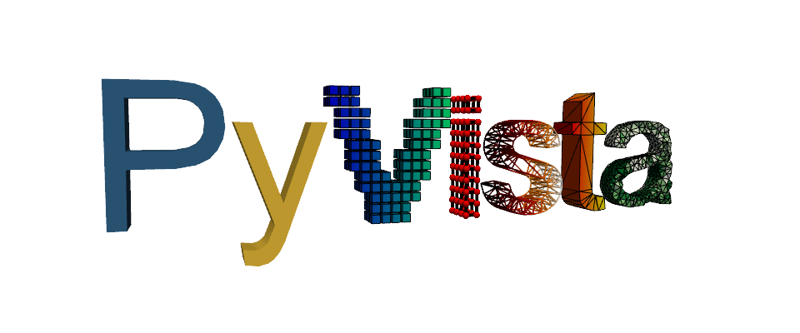

Processing and Visualization
Python libraries
OPEN3D
Trimesh
Pyvista
Pyntcloud

Slide 6
Processing and Visualization
Python libraries
OPEN3D
Trimesh
Pyvista
Pyntcloud

Slide 7
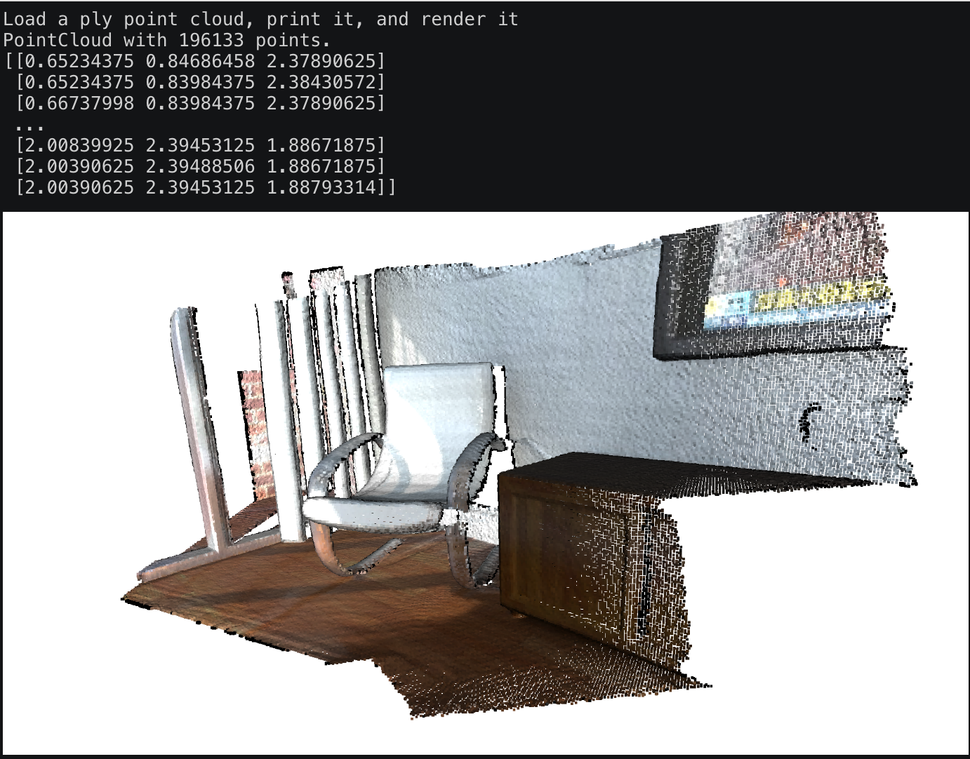
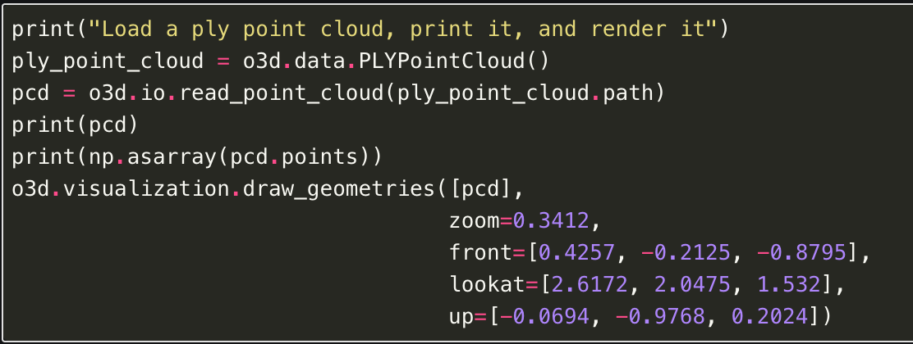
OPEN3D
Visualization

Slide 8
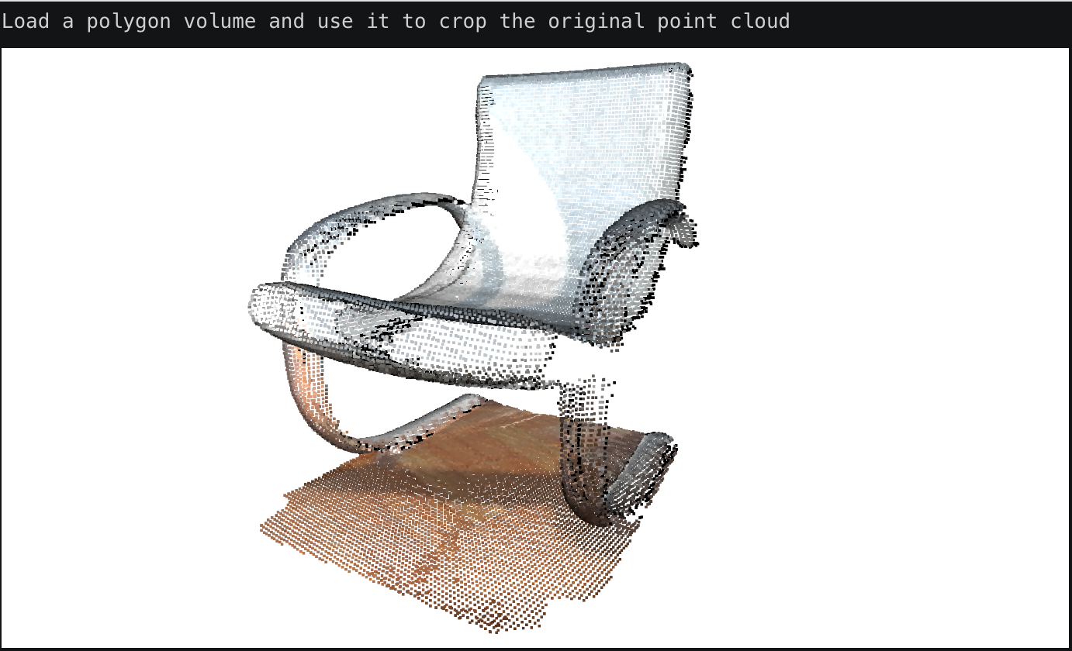
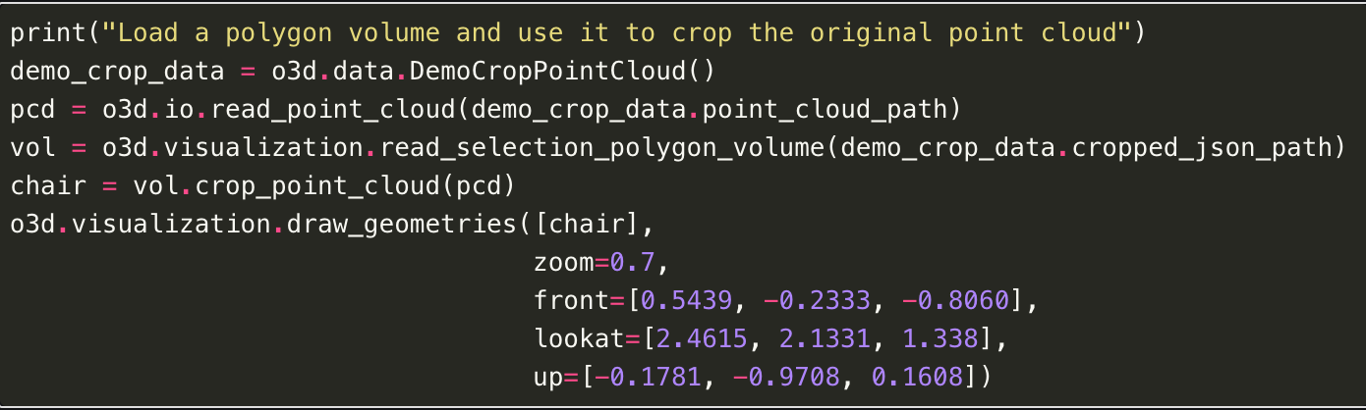
OPEN3D
Cropping

Slide 9
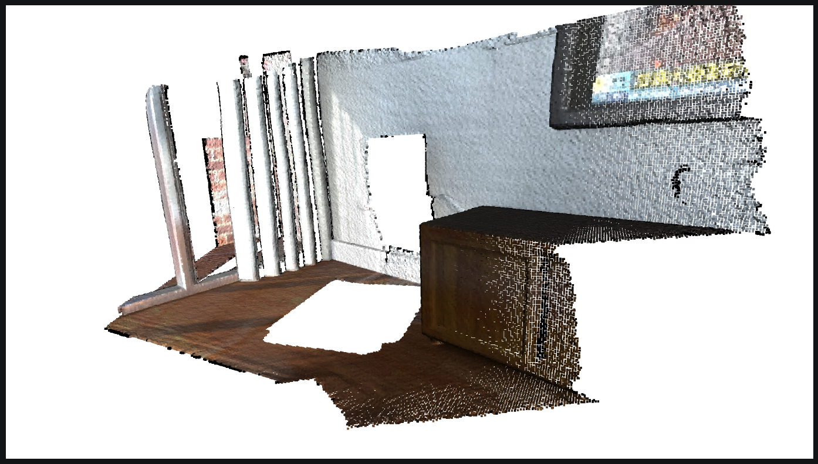
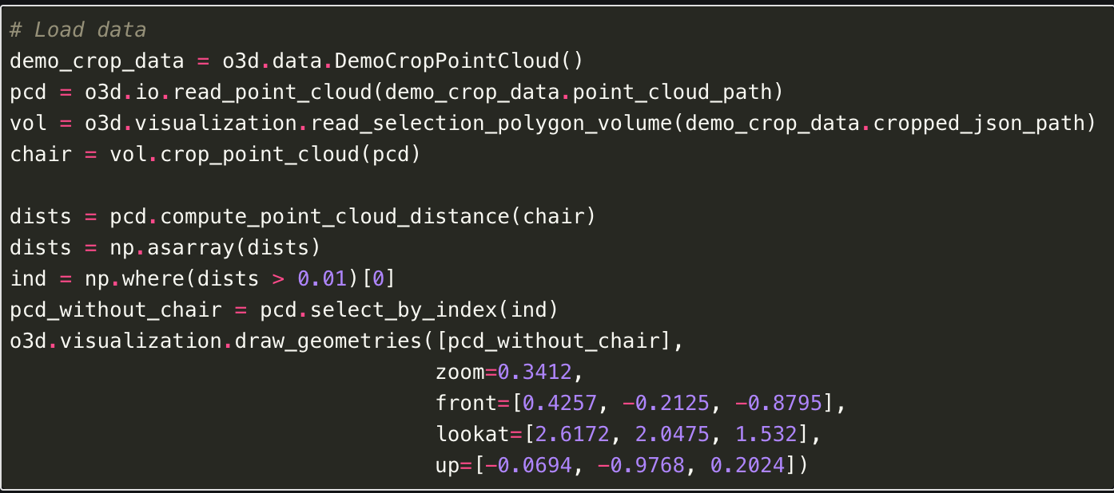
OPEN3D
Point cloud distance

Slide 10
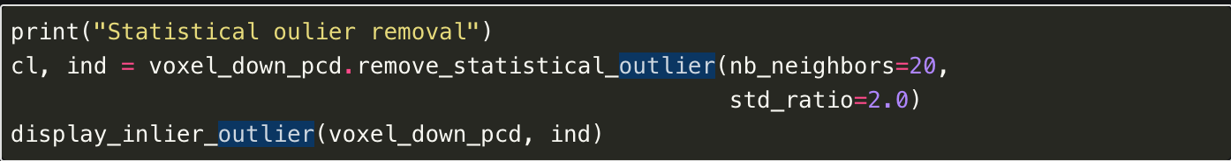
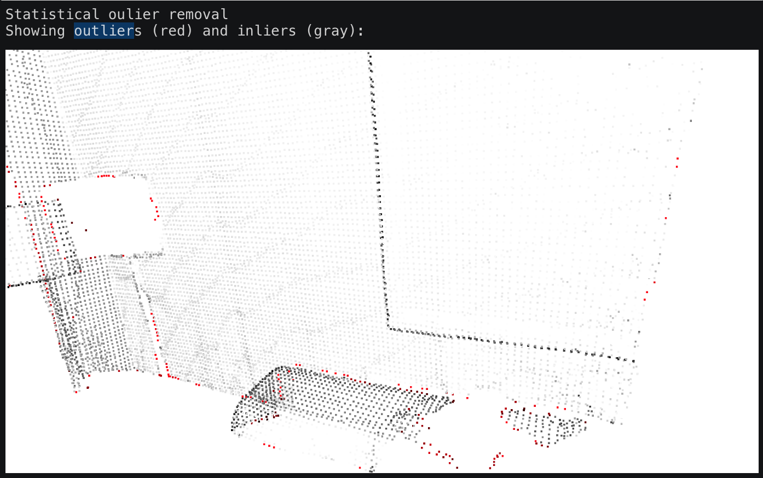
OPEN3D
Outlier removal

Slide 11
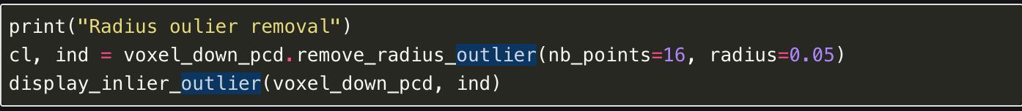
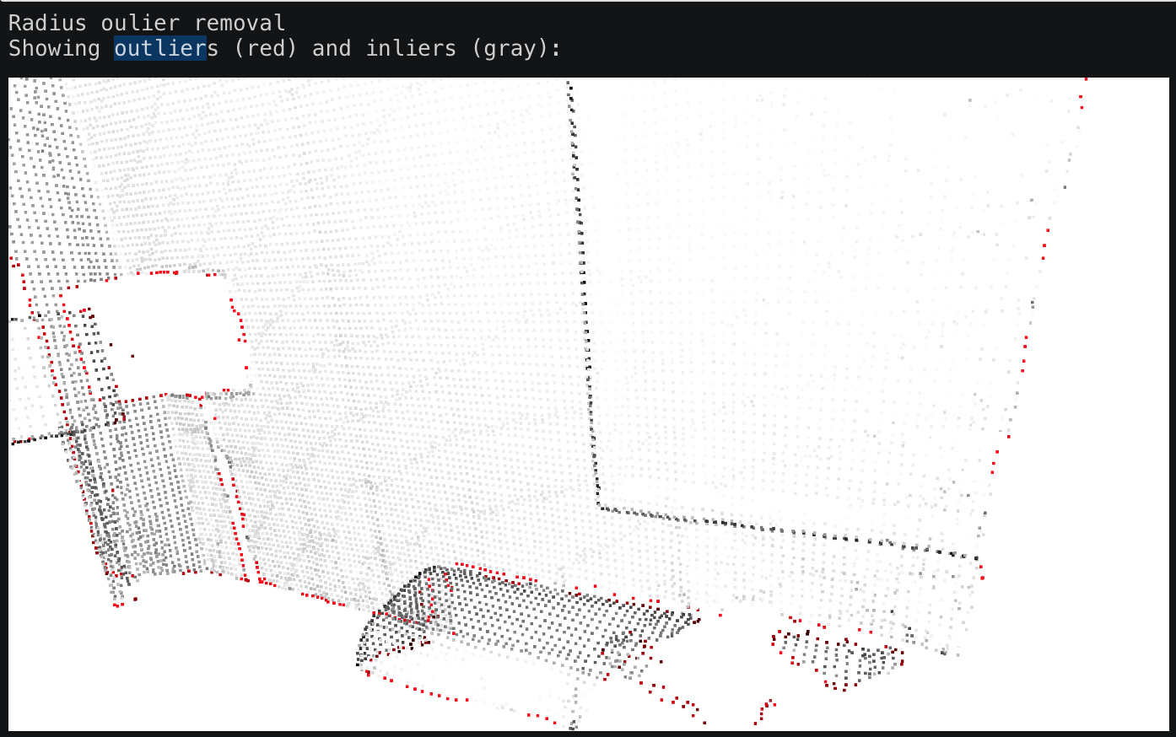
OPEN3D
Outlier removal

Slide 12
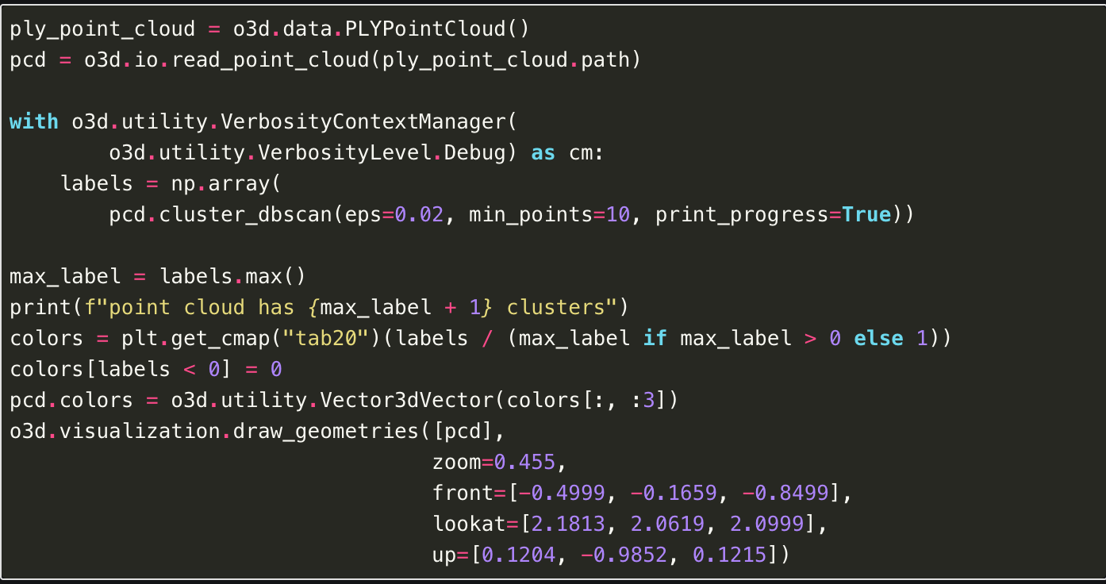
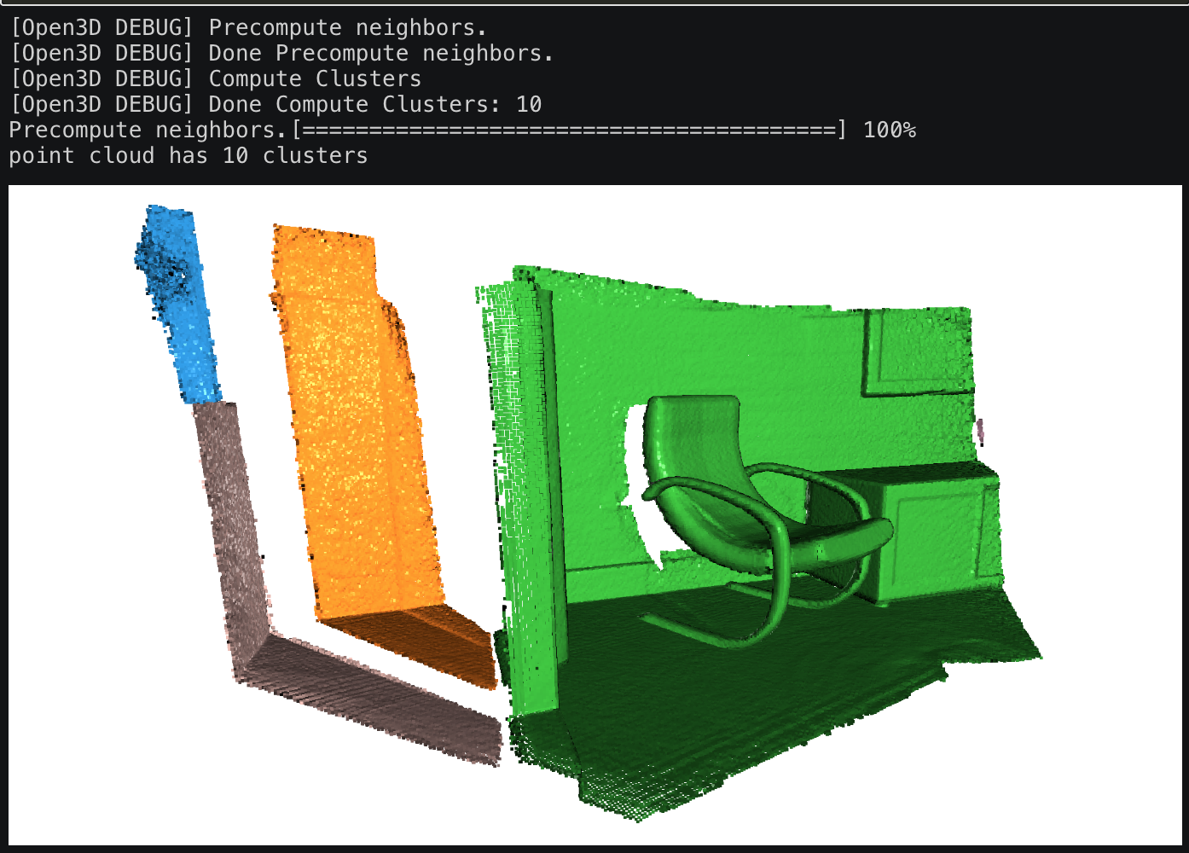
OPEN3D
Clustering

Slide 13
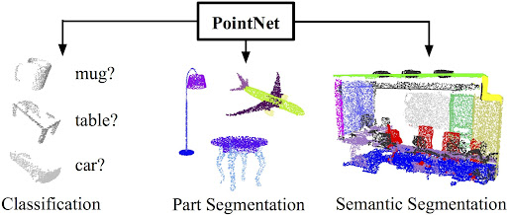
Deep learning for 3D Point Cloud
The pioneering work: PointNet
Input Point Cloud, N x 3

Slide 14
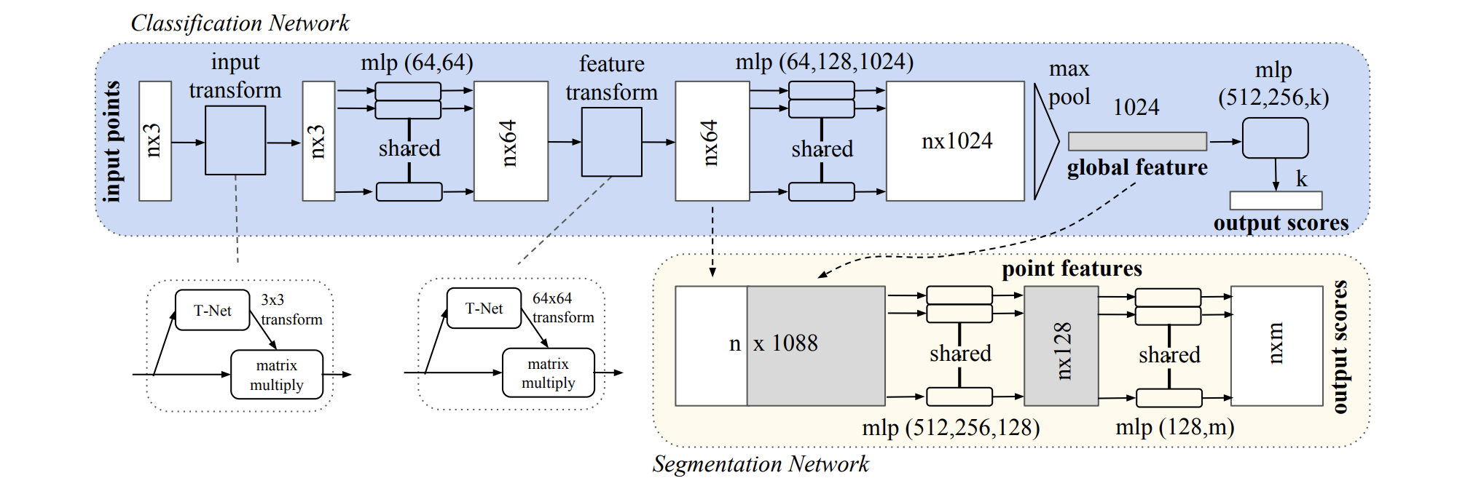
PointNet

Slide 15
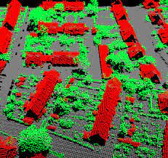
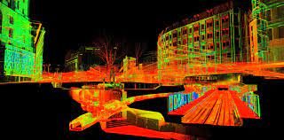
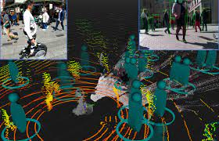
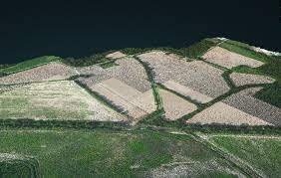
Real World Applications
Urban Planning
Environmental Monitoring
Architecture
Robotics
Agriculture
Archeology

Slide 16
Case Study: Crop Health Analysis
Height Analysis
Height directly related to yield potential
Expected height during phenotypic growth stages indicates the overall growth potential
Can reduce potential loss of crops.

Slide 17
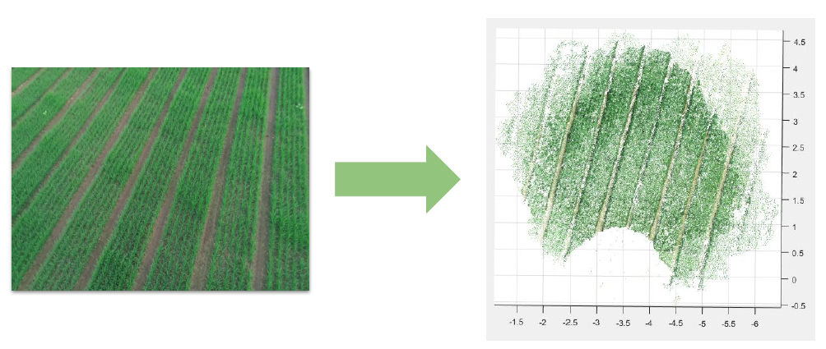
Step – 01: Reconstruct 3D Point Clouds From Drone Survey

Slide 18
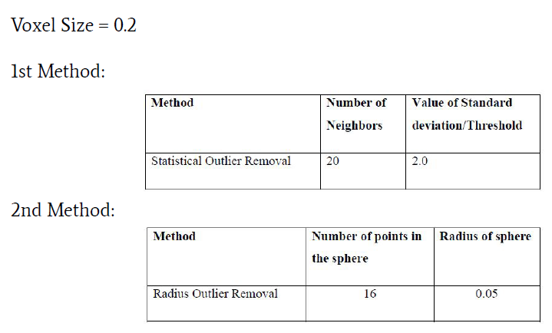
Step – 02: Outliers Removal using OPEN3D

Slide 19
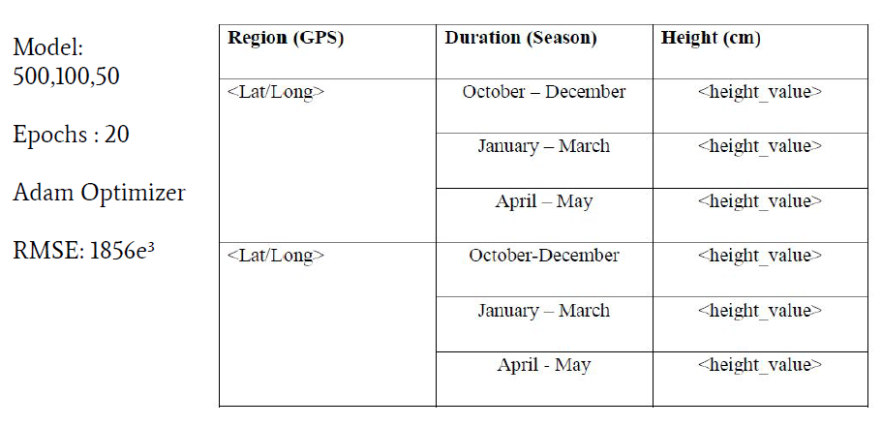
Step – 03: Lookup Table + Regression

Slide 20
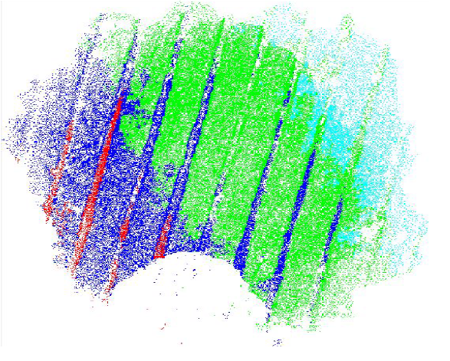
Output 2D Raster
Color ranges of height
Percentage difference
Estimate height using regression model.

Slide 21
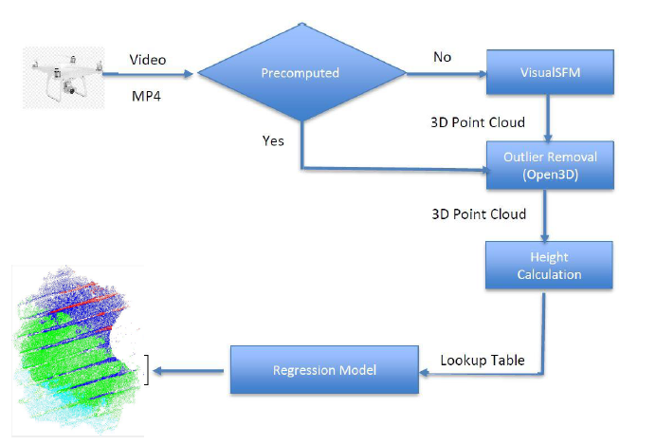
Architecture Diagram for Crop Height Estimation

Slide 22
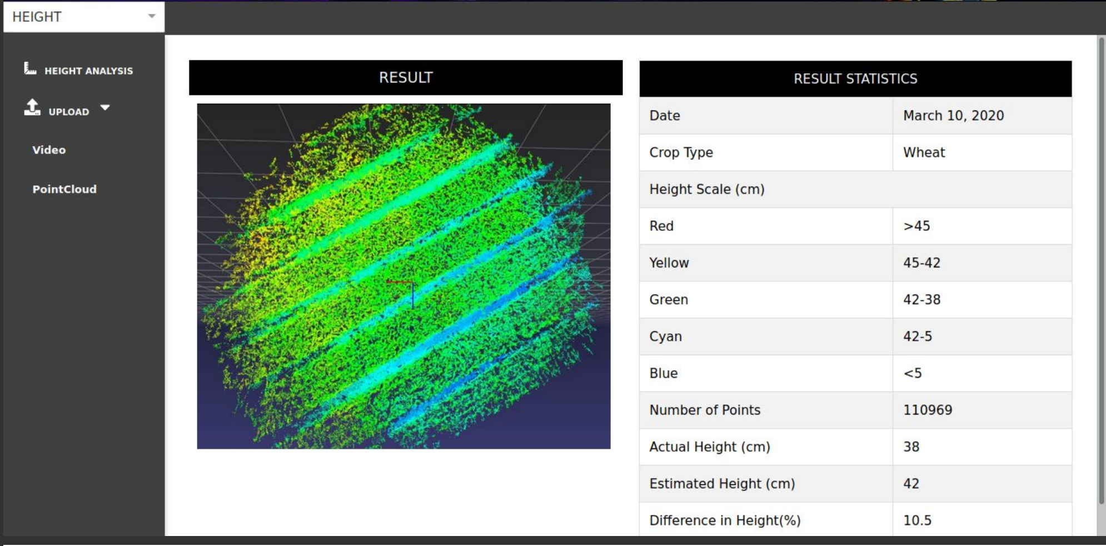
Web Application

Slide 23

Challenges of Point Cloud
Data Size and Complexity
Noise and Outliers
Feature Extraction and Segmentation
Real-time Processing

Slide 24

Future Directions of Point Cloud
Applications in AR/VR
AI Integration
Advance Sensor Technologies
Industry Specific Applications

Slide 25


